Slide 1
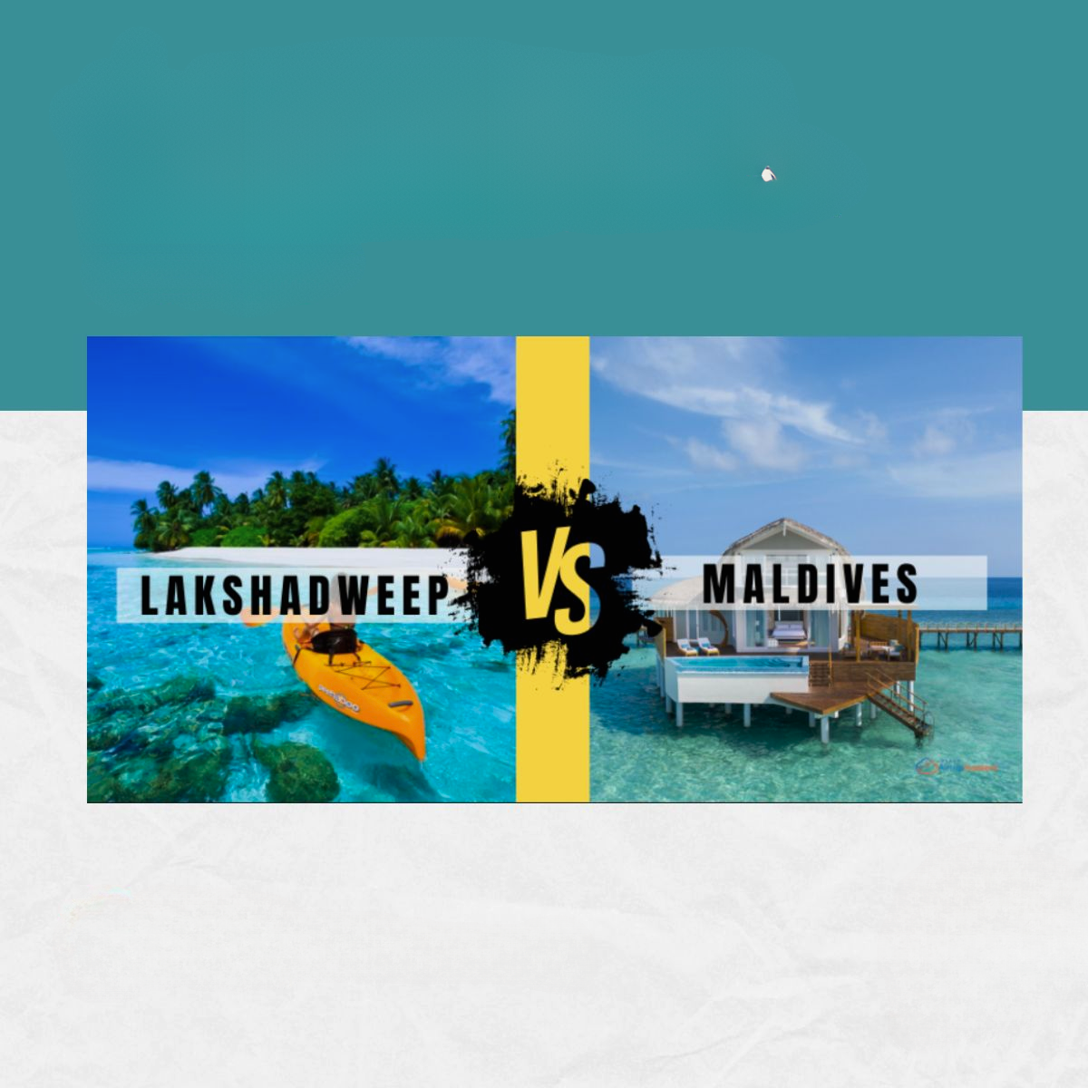





SQL
CASE STUDY
@Bandyopadhyay-Ankan

Slide 2

Challenge
To craft SQL queries to extract insights from the Maldives Vs Lakshadweep database.

Slide 3

TABLES
Destination
TouristAttractions
TouristArrivals
IndianTourists

Slide 4

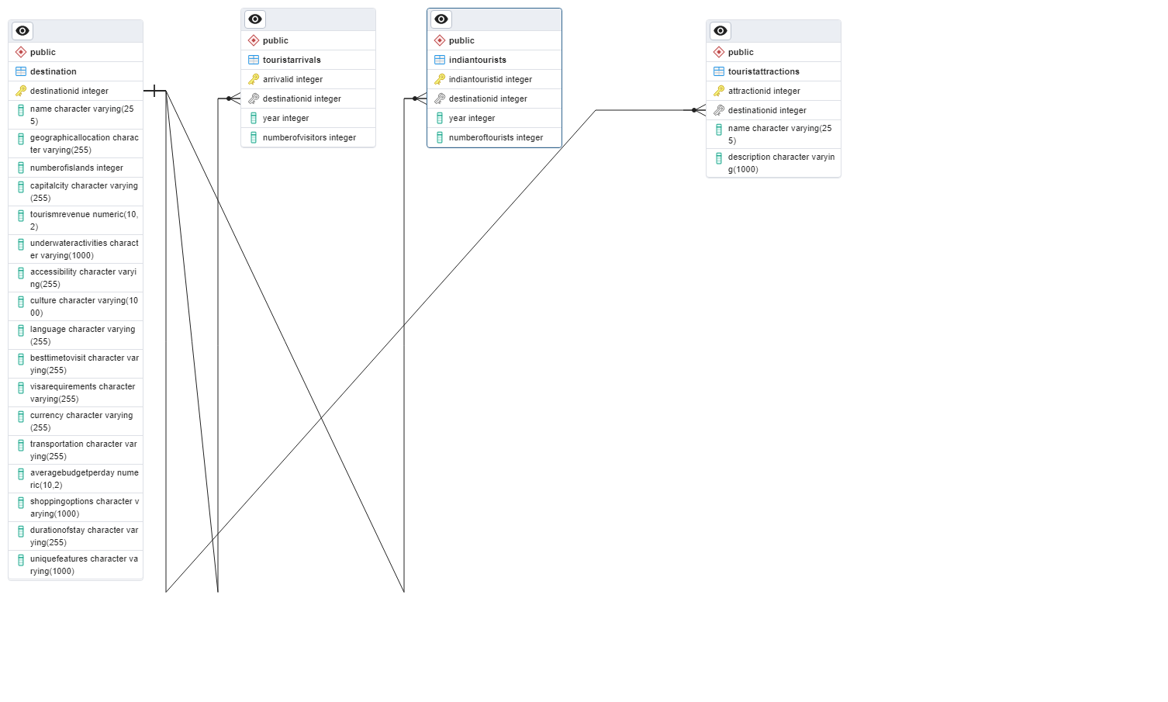
ERD:

Slide 5

QUESTIONS
1)Retrieve the number of visitors to the Maldives in 2019?
2)Retrieve the average budget per day and best time to visit for destinations with more than 10,000 tourists in 2022?
3)Retrieve the unique features of tourist attractions in Lakshadweep?
4)Retrieve the number of Indian tourists who visited the Maldives in 2021?
5)Find the destinations with the highest tourism revenue in 2022?

Slide 6

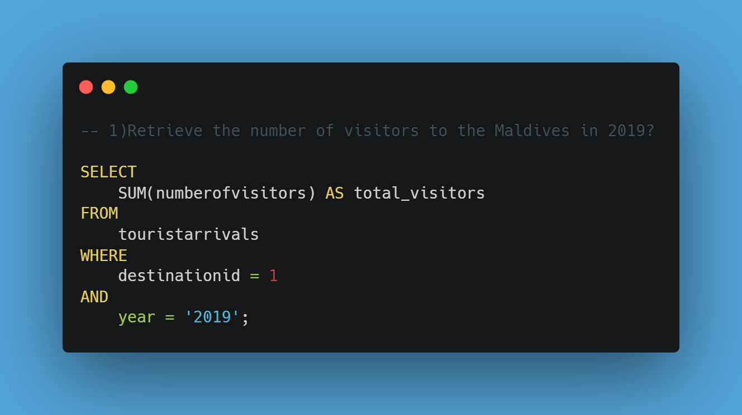

Slide 7

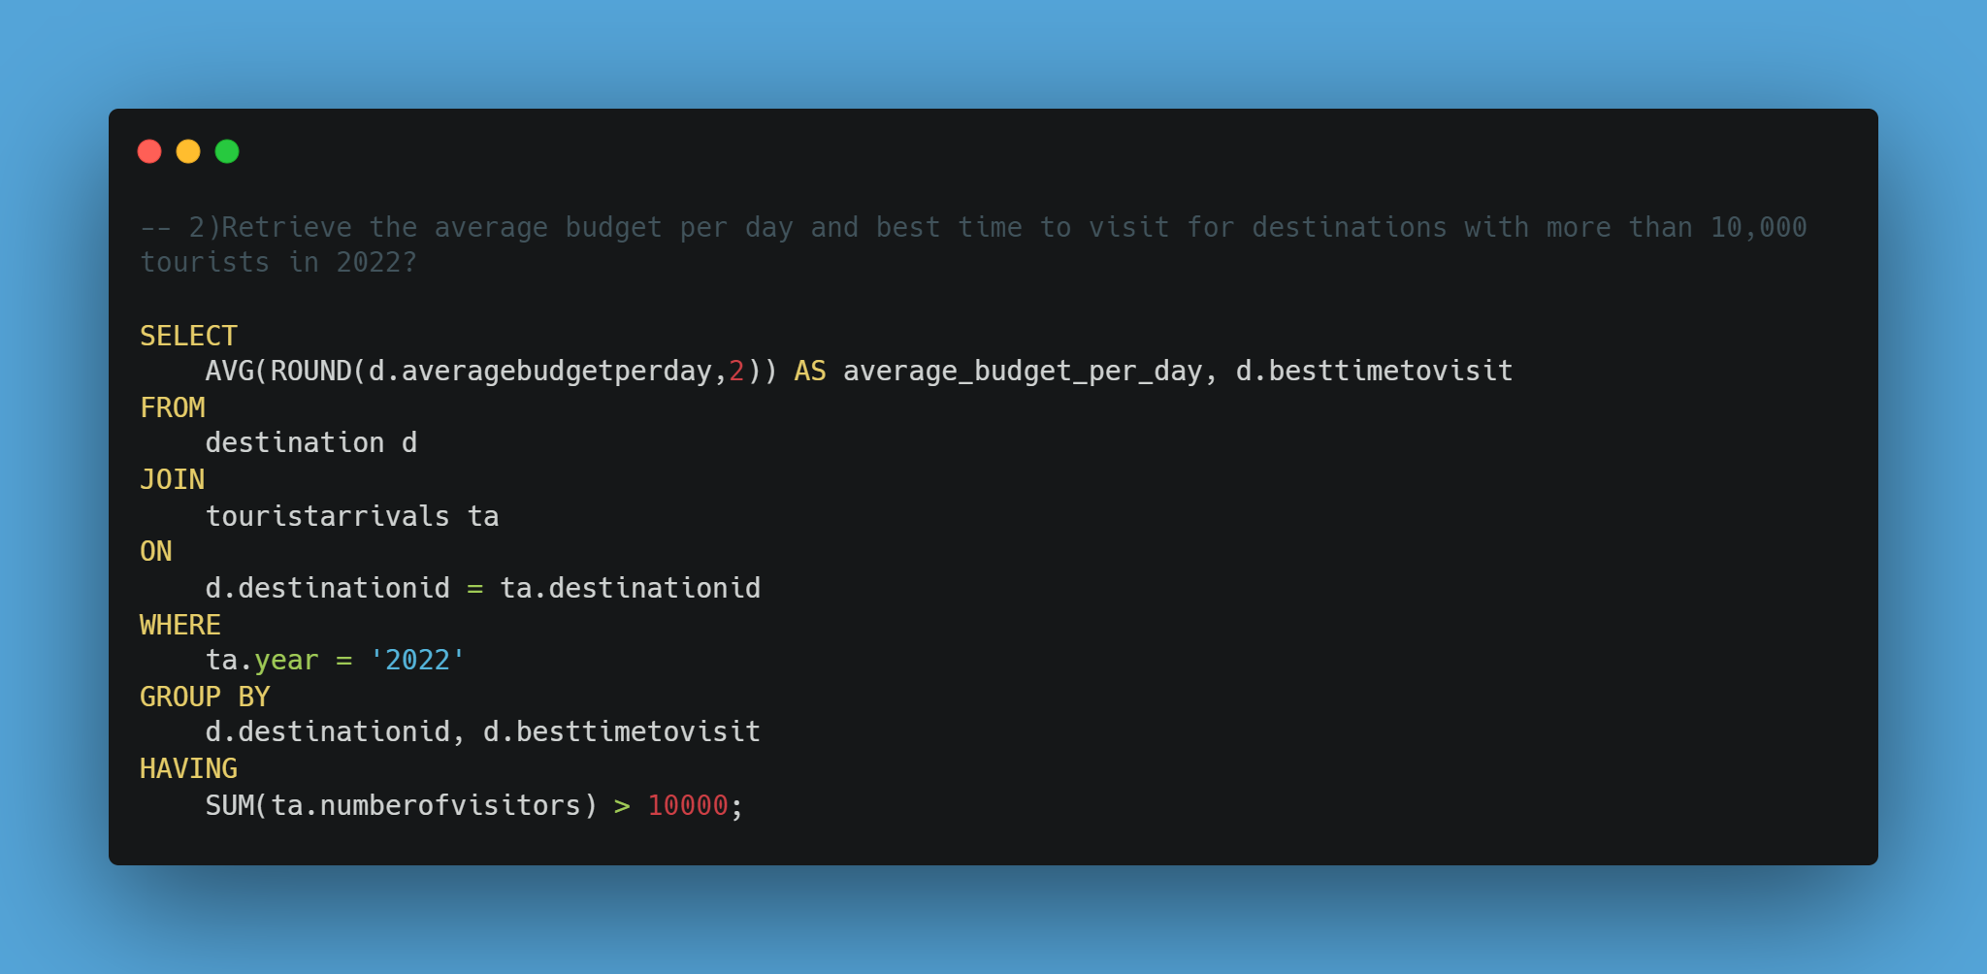

Slide 8

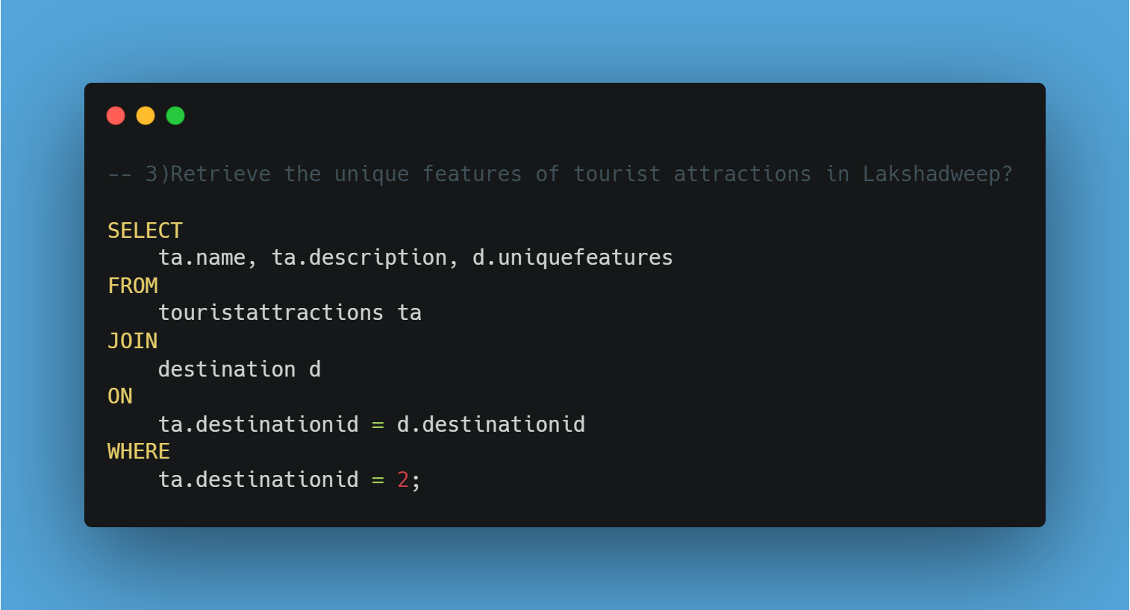

Slide 9

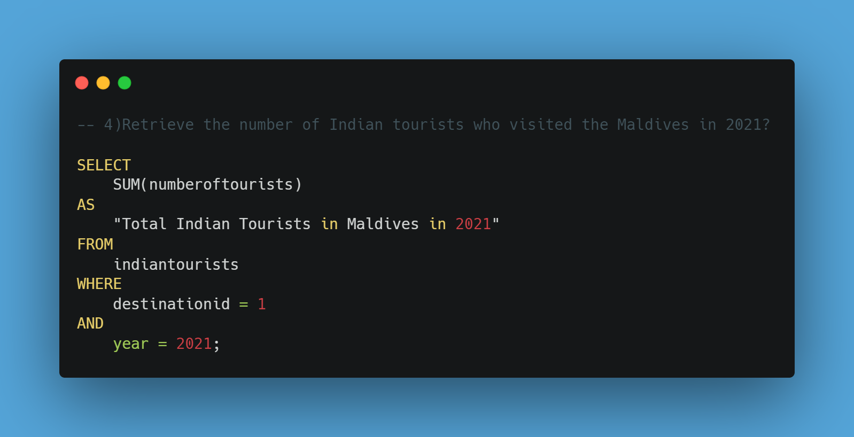

Slide 10
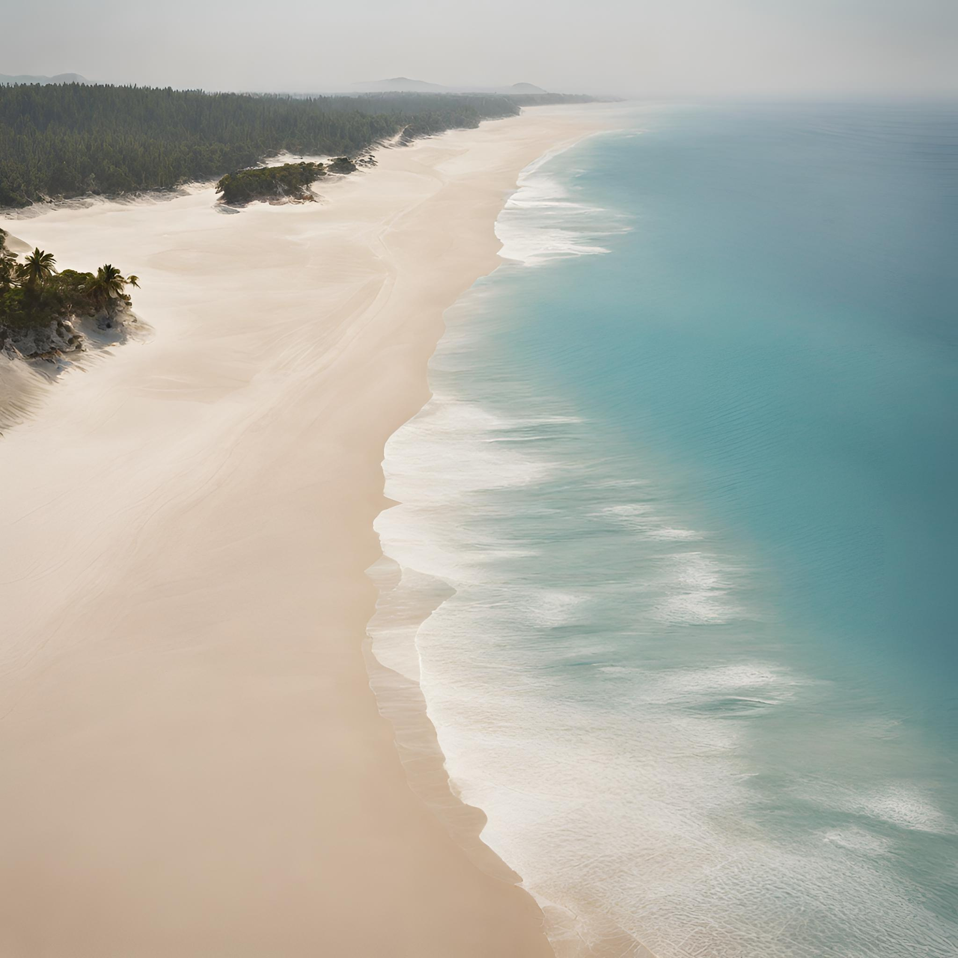
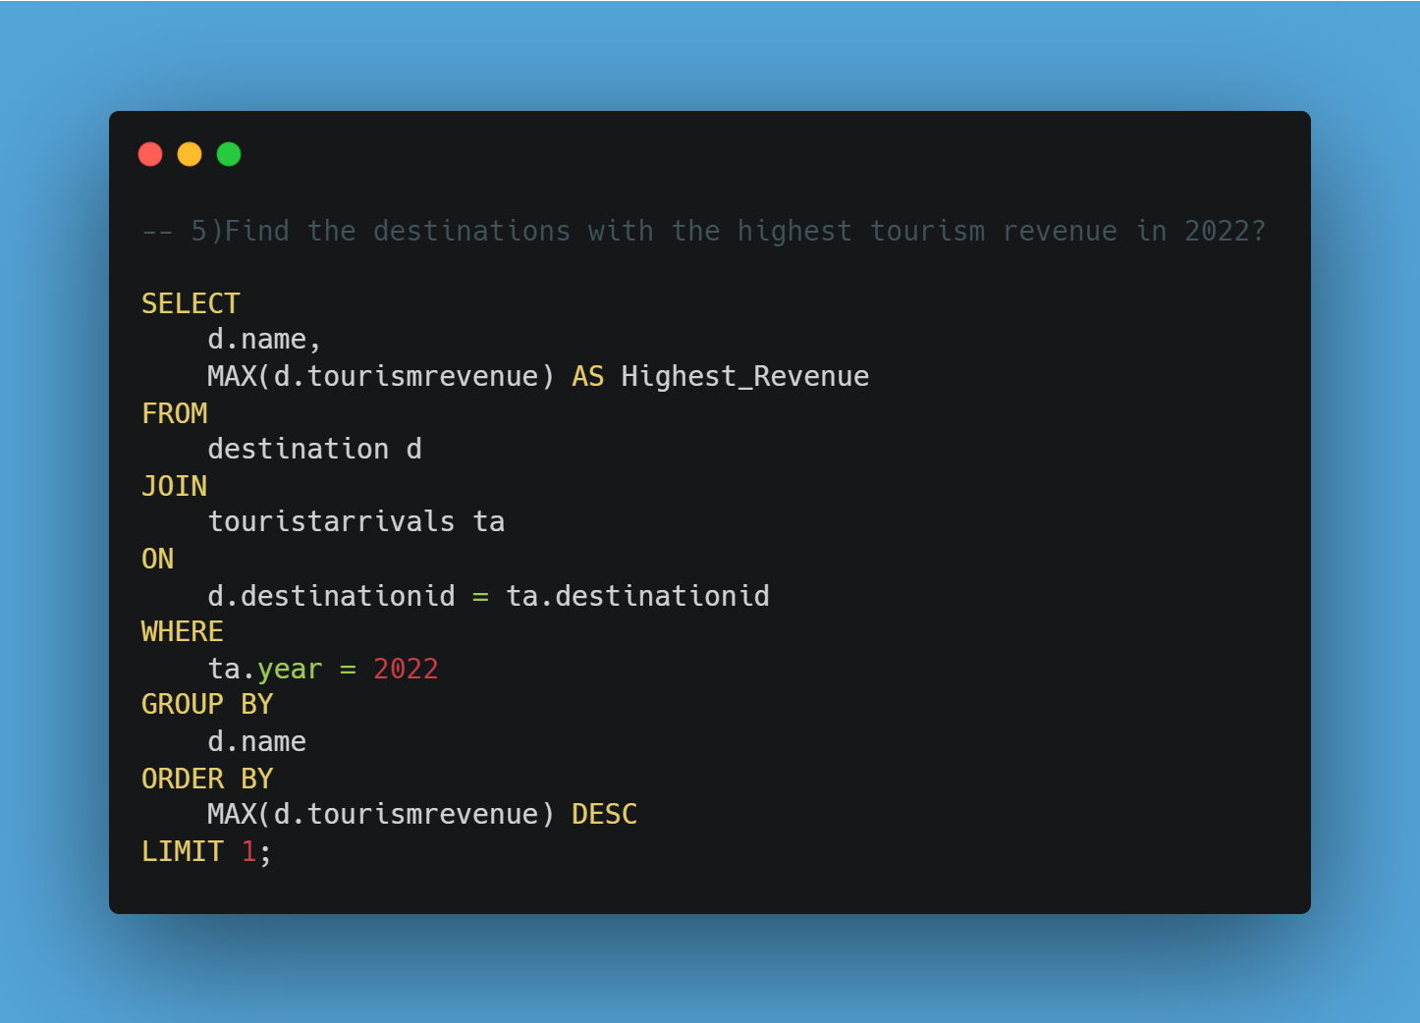

Slide 11



